Slide 1
Angular 4+

Slide 2
Schedule
Requirements
NG-CLI
Project Structure
Basics syntax
Components
Services
Routing
Karma

Slide 3
Requirements
NODE (https://nodejs.org/en/)
IDE - VSCode (https://code.visualstudio.com/) Atom (https://atom.io/)
npm install -g @angular/cli
Ng new blvblv
npm install - reload the dependency files.

Slide 4
NG-CLI
ng new - creates a new angular application
ng serve - launches the server, watches your files, and rebuilds the app as you make changes to those files
ng generate - Generate components, routes, services and pipes with a simple command. The CLI will also create simple test shells for all of these.
ng build - compiles the application into an output directory
ng test - Tests will execute after a build is executed via Karma, and it will automatically watch your files for changes.

Slide 5
Basic Syntax - Variables/Models Access
{{}} - Interpolation
[()] - two-way binding
[] - one-way binding
<input [(ngModel)]="name" #ctrl="ngModel" required>
<p>Value: {{ name }}</p>
<p>Valid: {{ ctrl.valid }}</p>
<button (click)="setValue()">Set value</button>

Slide 6
Project Structure
package.json
node_modules
src/app/app.module.ts

Slide 7
Basic Syntax - Structural Directives
*ngIf <div *ngIf="hero" class="name">{{hero.name}}</div>
*ngFor - <ul><li *ngFor="let hero of heroes">{{hero.name}}</li> </ul>
*ngSwitch
<div [ngSwitch]="hero?.emotion">
<app-happy-hero *ngSwitchCase="'happy'" [hero]="hero"></app-happy-hero>
<app-sad-hero *ngSwitchCase="'sad'" [hero]="hero"></app-sad-hero>
<app-confused-hero *ngSwitchCase="'app-confused'" [hero]="hero"></app-confused-hero>
<app-unknown-hero *ngSwitchDefault [hero]="hero"></app-unknown-hero>
</div>

Slide 8
Basic Syntax - Variables
var - DO NOT USE IT!
let - RECOMMENDED
const - An augmentation of let in that it prevents re-assignment to a variable.

Slide 9
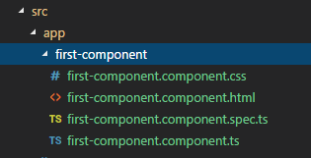
Components
ng g c first-component
contains all css code for this component
this file contains all html code
this file contains the unit tests
the typescript for this component

Slide 10
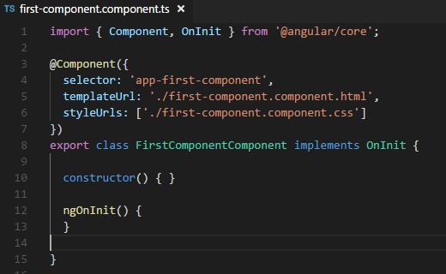
Component - TypeScript

Slide 11
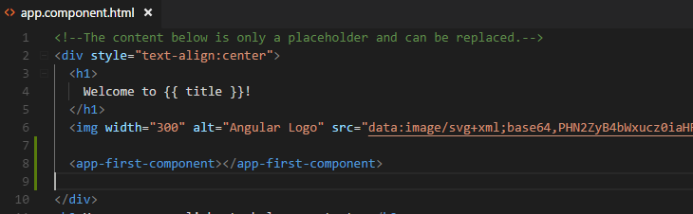
Components - The use

Slide 12
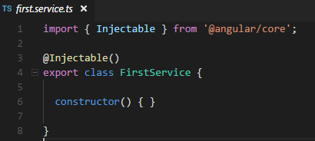
Service
ng g s first

Slide 13
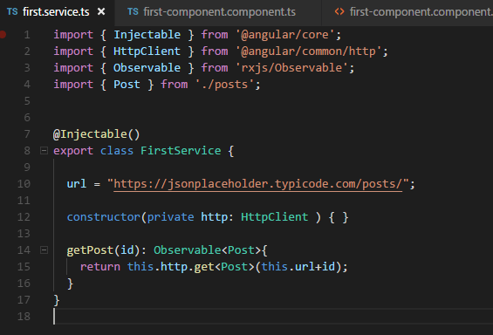
Service - Calling API

Slide 14
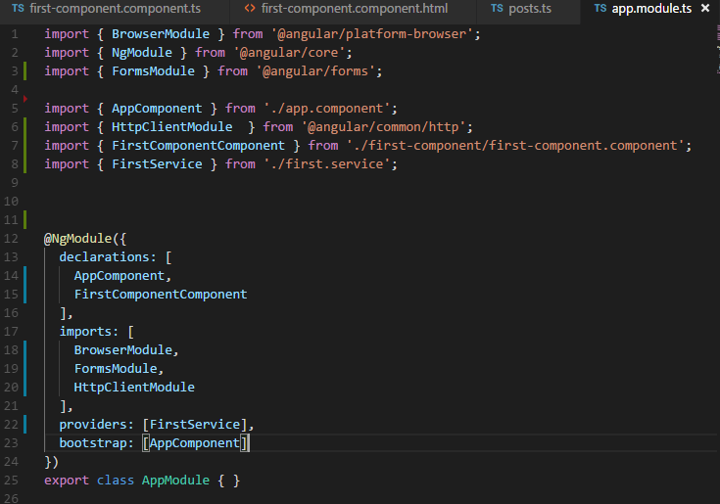
Service - Providers on app.Module

Slide 15
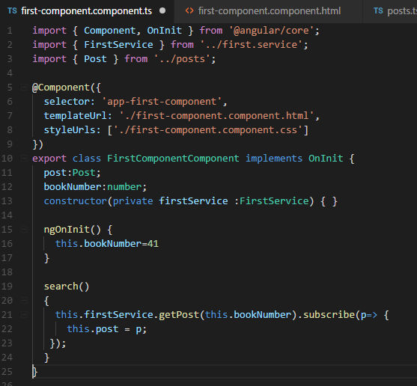
Service - The Use

Slide 16
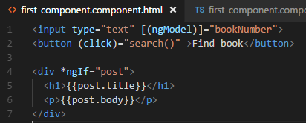
Service - The Use

Slide 17
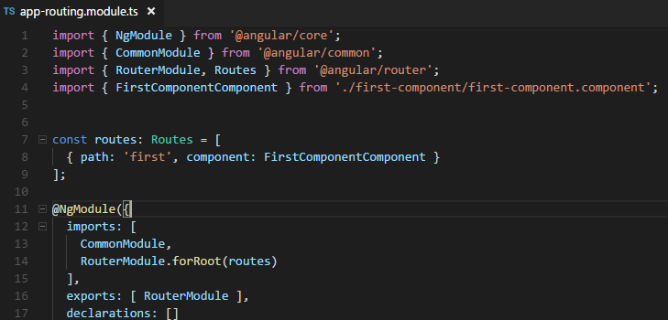
Routing
ng generate module app-routing --flat --module=app

Slide 18
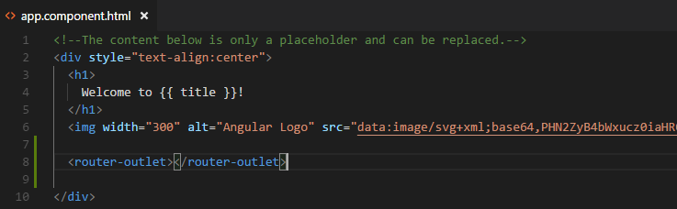
Routing - RouterOutlet
and the FirstComponent will show only when the URL is:
http://localhost:4200/first

Slide 19
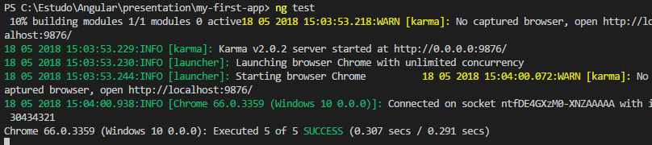
Karma
ng test

Slide 20
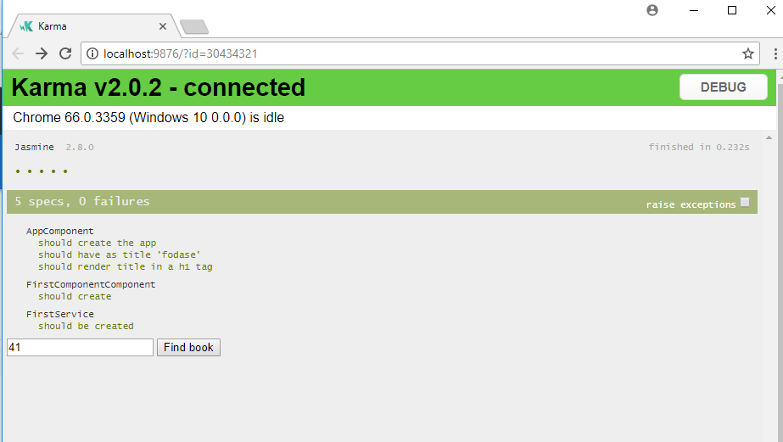
Karma

